Slide 1


Supermart Grocery Sales: A Retail Analytics Project
This project delves into a fictional dataset designed for data analysts to hone their skills in exploratory data analysis and data visualization. The dataset encompasses orders placed by customers on a grocery delivery application, specifically within the state of Tamil Nadu, India. The primary focus is to leverage this dataset for a machine learning project aimed at predicting sales or profit.
The project involves data exploration, feature engineering, and the construction of a machine learning model. The dataset includes columns such as Order ID, Customer Name, Category, Sub Category, City, Order Date, Region, Sales, Discount, Profit, State, month_no, Month, and year.
by Neha Rastogi

Slide 2
Data Loading and Preprocessing
The initial steps involve importing necessary libraries such as pandas, numpy, matplotlib, and scikit-learn. The dataset, named 'supermart_grocery_sales.csv', is loaded into a pandas DataFrame. Missing values are checked and handled by dropping rows with any missing entries. Duplicate entries are also removed to ensure data integrity.
Date columns, specifically 'Order Date', are converted to DateTime format to facilitate time-based analysis. Day, month, and year are extracted into separate columns for further feature engineering. Categorical variables including Category, Sub Category, City, Region, State, and Month are transformed into numerical representations using Label Encoding.
Missing Values
DateTime Conversion
Label Encoding
Handling missing data to ensure data quality.
Transforming categorical variables into numerical values.
Converting date columns for time-based analysis.

Slide 3
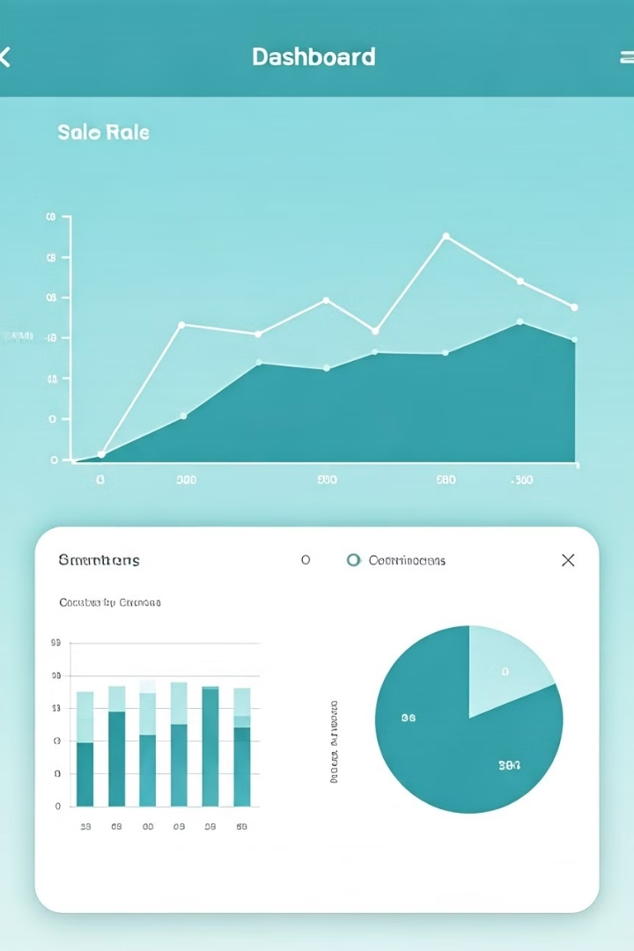



Exploratory Data Analysis (EDA)
Exploratory Data Analysis (EDA) is conducted to gain insights into the dataset. This includes visualizing the distribution of sales by category using box plots, examining sales trends over time by plotting total sales against the order date, and generating a correlation heatmap to understand the relationships between different variables.
These visualizations help in identifying patterns, outliers, and correlations that can inform feature selection and model building. The EDA process provides a comprehensive understanding of the data's characteristics and potential predictive variables.
Sales Distribution
Sales Trends
Correlation Heatmap

Slide 4
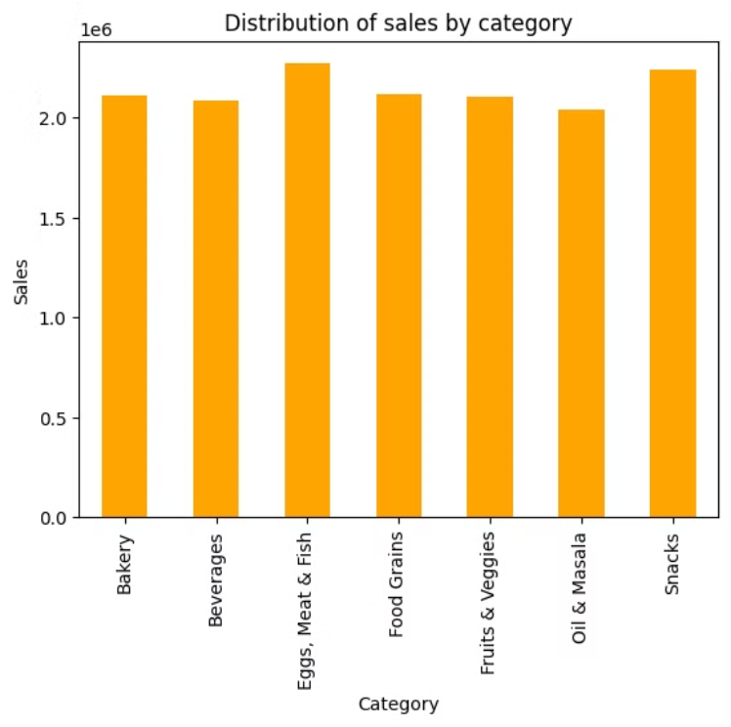
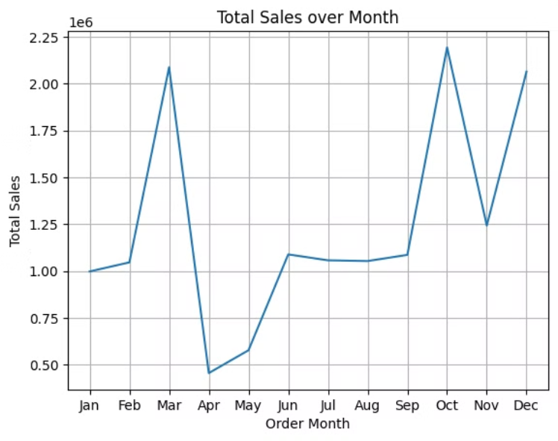

Slide 5
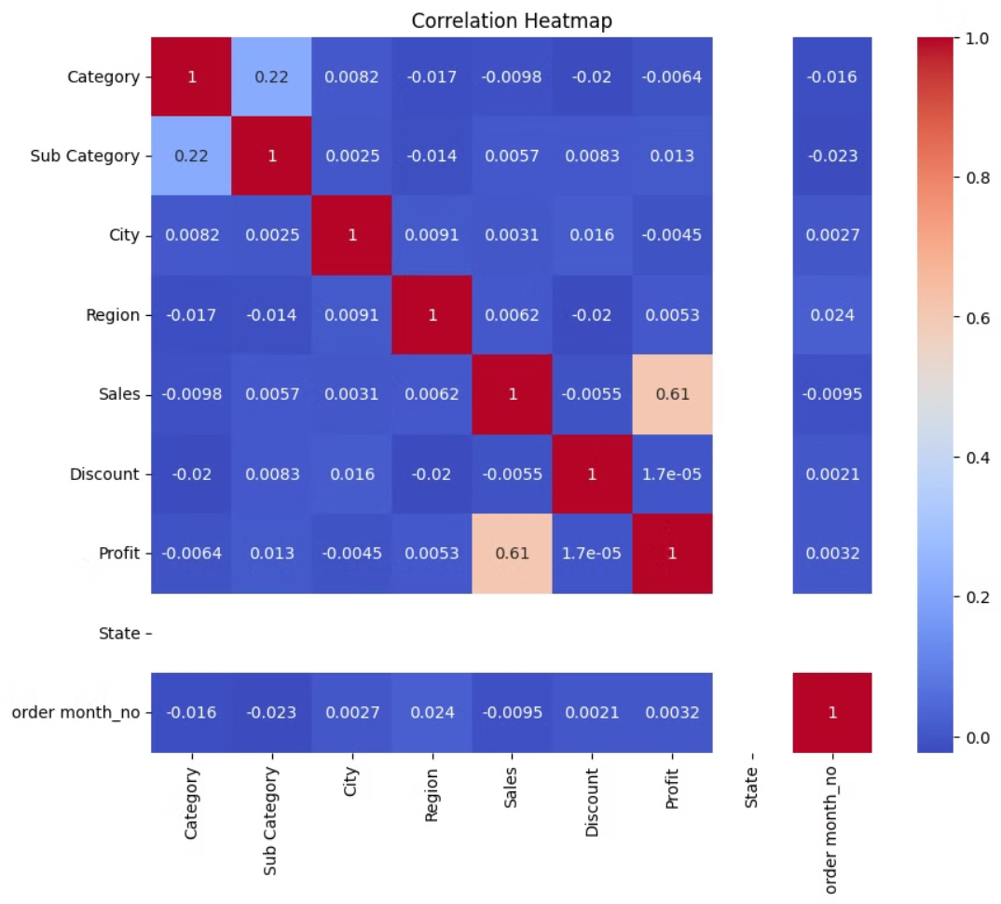

Slide 6
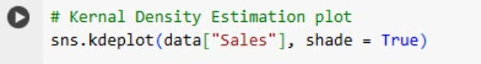
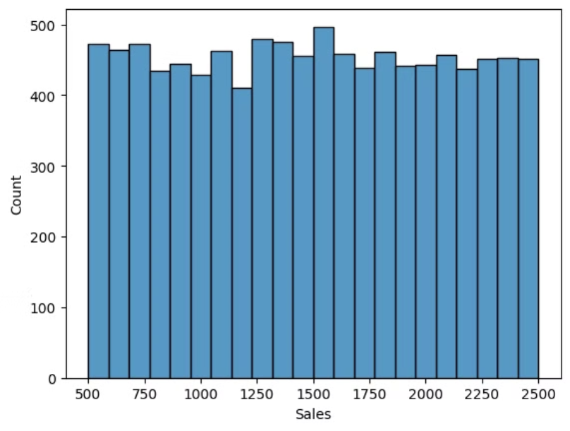
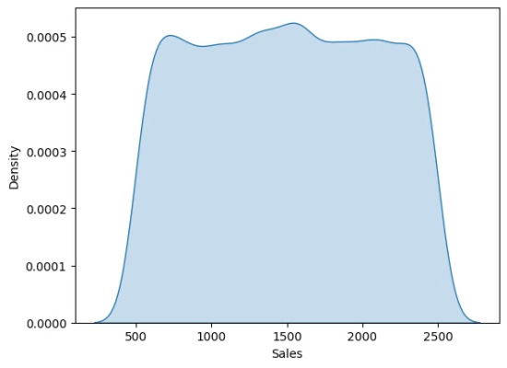

Slide 7
Feature Selection and Data Splitting
Relevant features are selected for model building, excluding columns such as 'Order ID', 'Customer Name', 'Order Date', 'Sales', and 'Month'. The target variable is 'Sales'. The dataset is then split into training and testing sets using an 75/25 ratio, with a random state of 101 for reproducibility.
Feature scaling is performed using StandardScaler to normalize the numerical features, ensuring that all features contribute equally to the model's learning process. This step is crucial for improving the performance and convergence of the linear regression model.
Selected Features
Data Splitting
Category
Training set: 75%
Sub Category
Testing set: 25%
City
Region
State
month_no
Discount
Profit

Slide 8
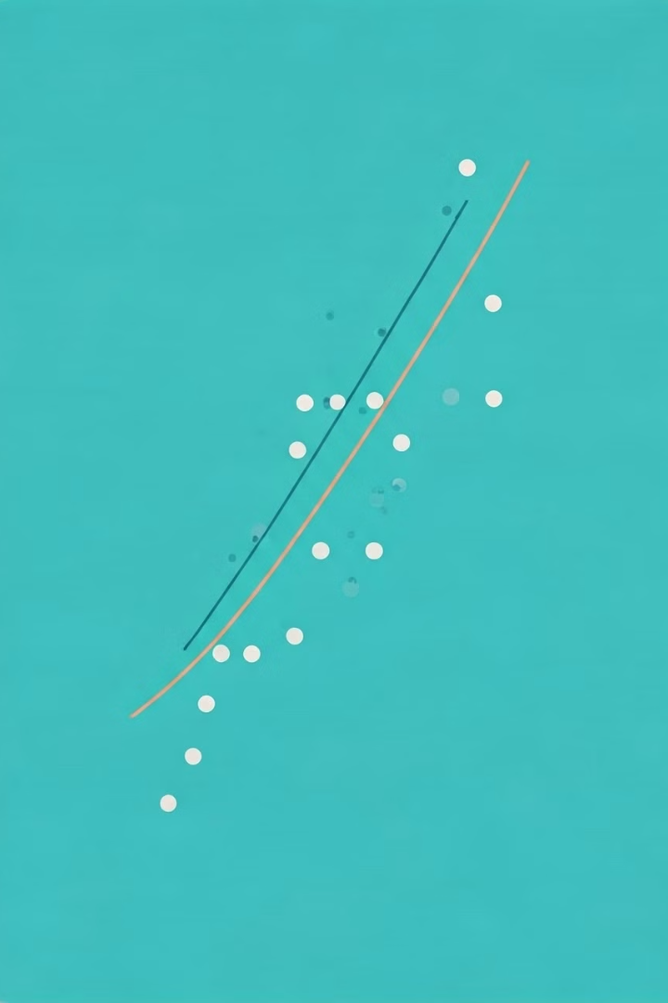



Linear Regression Model Training
A linear regression model is initialized and trained using the training data. The model learns the relationship between the selected features and the target variable ('Sales'). After training, the model is used to make predictions on the testing data.
The predicted sales values are then compared to the actual sales values to evaluate the model's performance. This process involves calculating metrics such as Mean Squared Error (MSE) and R-squared to quantify the accuracy and goodness-of-fit of the model.
Initialization
Initialize Linear Regression Model
Training
Train the model with training data
Prediction
Make predictions on testing data

Slide 9

Model Evaluation and Results
The linear regression model's performance is evaluated using Mean Squared Error (MSE) and R-squared. The MSE measures the average squared difference between the predicted and actual sales values, while the R-squared indicates the proportion of variance in the target variable that can be explained by the model.
The sample output shows an MSE of 1758.26 and an R-squared of 0.82, suggesting that the model provides a reasonable prediction for sales based on the selected features. An R-squared value of 0.82 indicates that the model explains a significant portion of the variance in sales.
1758.26
MSE
Mean Squared Error
0.82
R-squared
Variance Explained

Slide 10


Visualization of Actual vs Predicted Sales
A scatter plot is generated to visualize the relationship between actual and predicted sales values. The plot includes a red line representing the ideal scenario where predicted values match actual values. Deviations from this line indicate the model's prediction errors.
This visualization provides a clear understanding of how well the model's predictions align with the actual sales data. It helps in identifying potential areas where the model may be over- or under-predicting sales, which can inform further model refinement and feature engineering.
Actual Sales
Predicted Sales
1
2
Observed sales values
Model's sales predictions

Slide 11
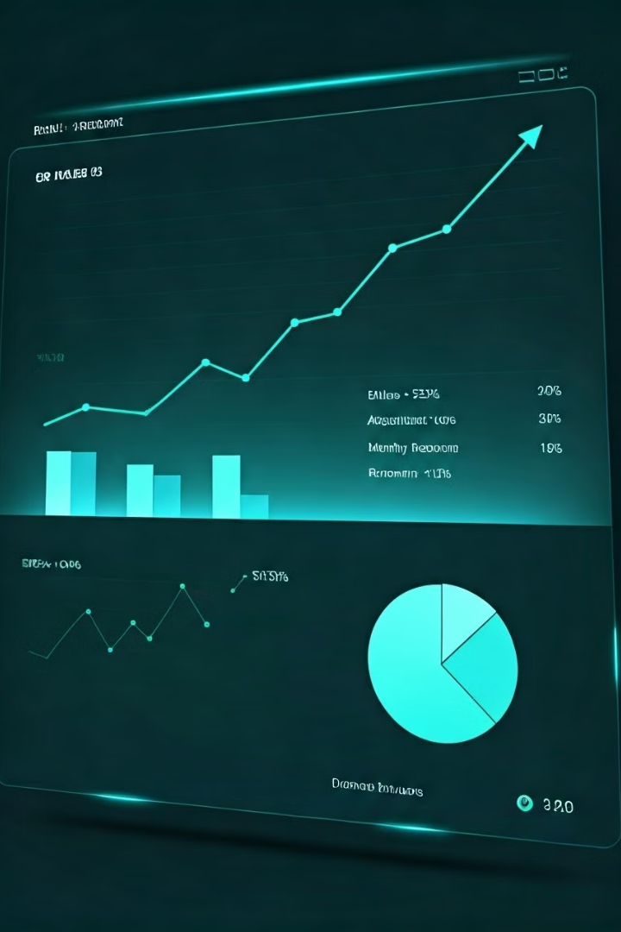
Conclusion and Next Steps
The linear regression model provides a reasonable prediction for sales based on the selected features, with an R-squared value indicating a good fit. Further refinement of the model could involve trying different machine learning algorithms, such as decision trees or ensemble methods, to improve predictions.
Next steps include experimenting with more complex models like Random Forest or XGBoost to improve predictions, exploring additional features or interactions between features to enhance model performance, and integrating the model into a dashboard for real-time sales prediction and business analytics.
Advanced Modeling
Feature Engineering
Experiment with Random Forest or XGBoost.
Explore additional features or interactions.
Model Deployment
Integrate into a dashboard for real-time analytics.

